Slide 1
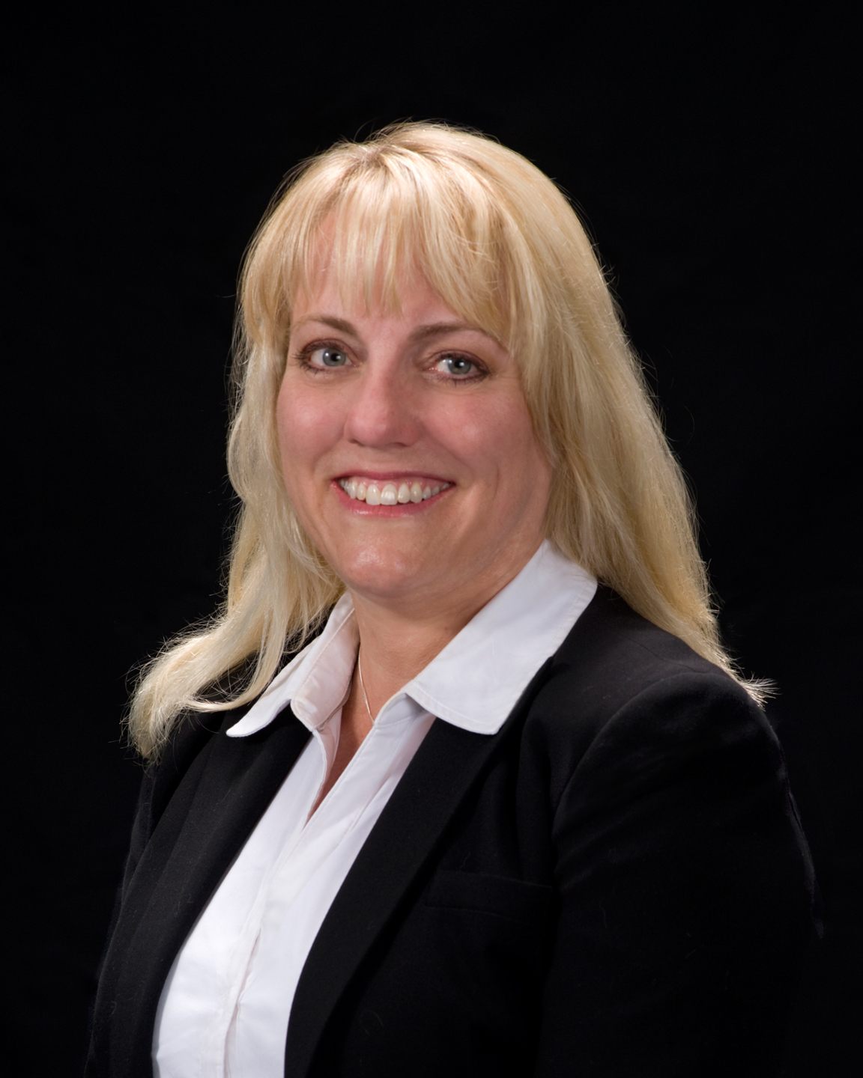
Carol Duberowski Regional Representative
Visiting here: {DATE}
FMF Financial Services offers
a variety of Christian stewardship services
to help you manage the resources
entrusted to your care.
FMFfinancial.org

Slide 2
FMF Financial Services can help you answer questions such as:
How can I best plan for my financial future?
Am I saving enough?
Am I on track for retirement?
Do I need a will or a trust?
What are some tax-wise gifting strategies?
Coming: {DATE}
Contact the church office to set up an appointment.
We look forward to meeting with you!

