Slide 1
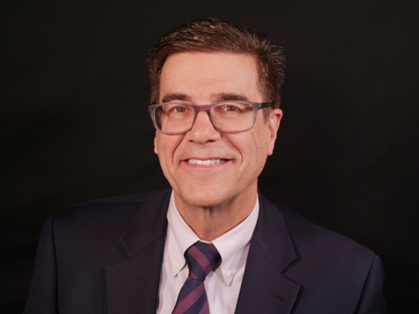
Learn How to “Virus Proof” your Documents and Plans
Arnie Brann LIVE!
Call for a personal
Zoom or Phone Meeting…
Health Care Power of Attorney- Talking to Health Care providers when you can’t.
Living Will- End of Life Decisions- going too far?
Durable Power of Attorney- managing your finances when you can’t
Arnie Brann
Regional Vice President
Documents that Make a Difference
Last Will and Testament
Revocable Living Trust
Creating Plans with a Purpose
Maximizing gifts for family and your favorite ministries
Call, Text or Email Arnie for your online link at (206) 579-1974
abrann@fmfoundation.org

